Slide 1
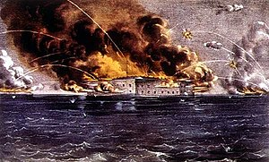

Bombardment of Fort Sumter

Slide 2
Where are we in the path to Civil War?
In a shocking turn of events, the Republican Party nominated Abraham Lincoln for President. With only 40% of the popular vote, Lincoln won the election, despite being left off of the ballot in most Southern states.
Following the election of Lincoln, and with the future of slavery in serious doubt, South Carolina became the first state to secede from the Union. Six other states soon followed suit. We are on the “doorstep” to Civil War.
We Start in 1860

Slide 3
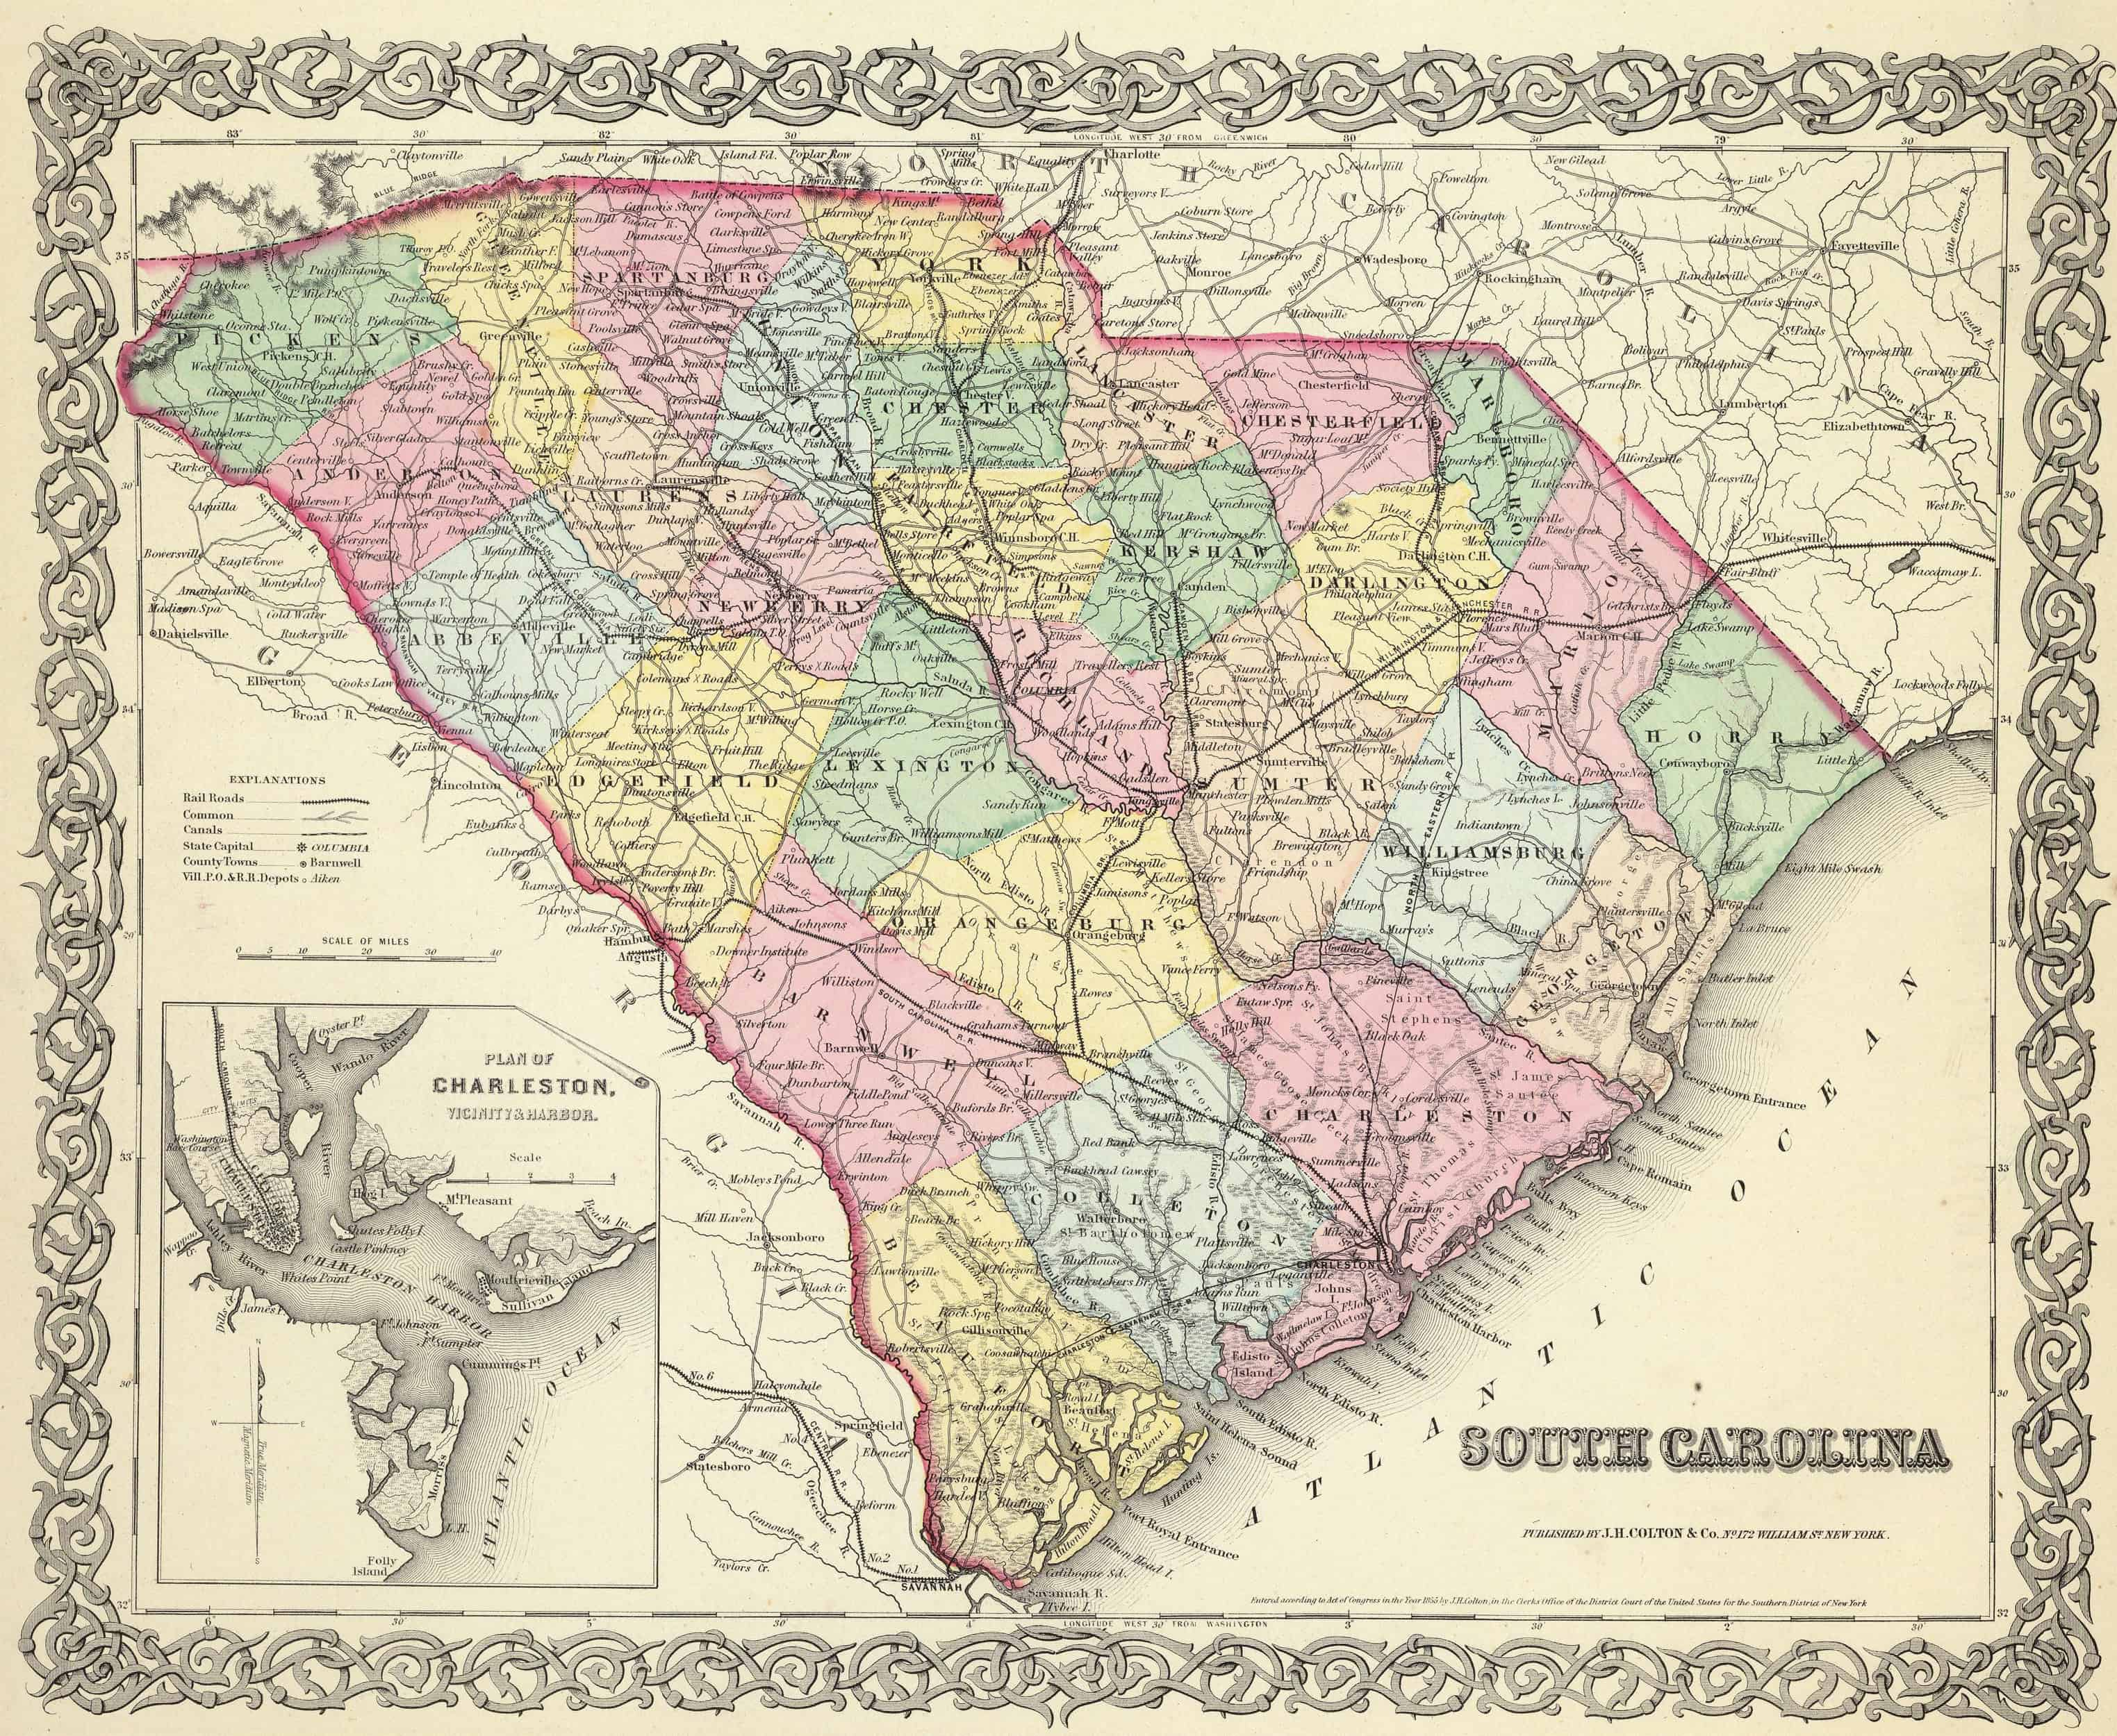
South Carolina
Became the 8th state to ratify the United States Constitution in 1788.
Had stirred up trouble before – In 1832, it declared the Tariffs of 1828 and 1832 unconstitutional, giving rise to the Nullification Crisis of 1832. These tariffs were designed to protect Northern industry by taxing low-priced material from Europe. Could a state defy a federal law? Should states’ right supersede federal mandates?
By the mid 1800’s, the state’s economy was largely tied to the production of cotton. Over 400,000 were enslaved in South Carolina.
Became the first state to secede from the Union in 1860.

Slide 4
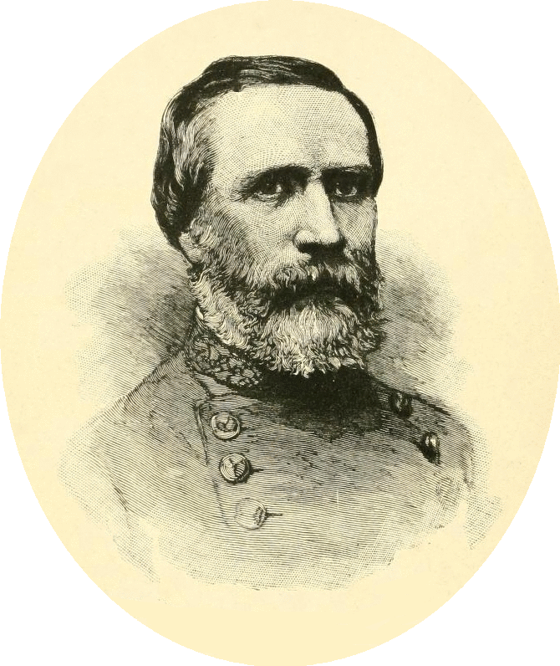
What to do?
Following its secession, South Carolina demanded that federal military forces immediately evacuate all forts in the state.
Union Major General Richard Anderson moved his troops from Fort Moultrie to Fort Sumter, in Charleston Harbor, because he thought it more easily defended.
South Carolina seized all forts other than Sumter.

Slide 5
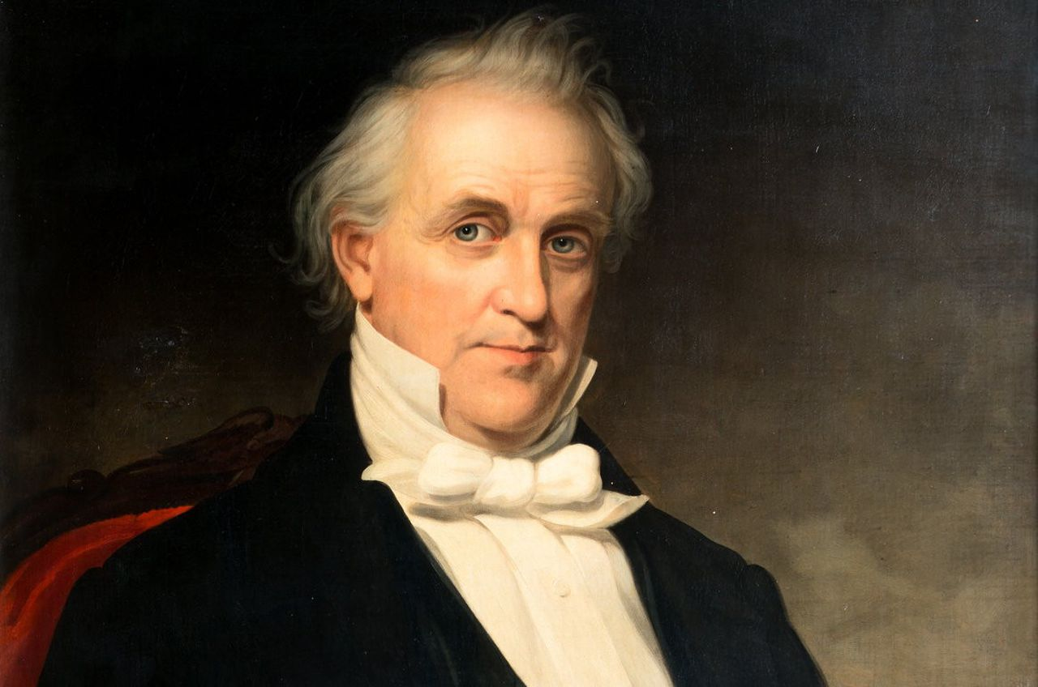
South Carolina Fires First
At the time, James Buchanan was still President.
He authorized the delivery of reinforcements to the soldiers within Fort Sumter.
Reinforcements failed to arrive because the ships carrying them were fired upon by batteries from the South Carolina shore.

Slide 6
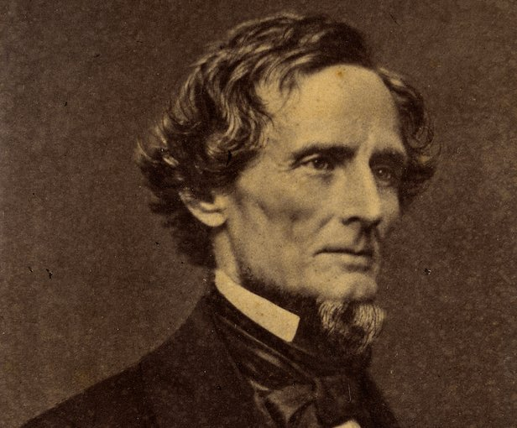
During this Time…
Jefferson Davis was appointed as the first President of the Confederate States of America.
His first military appointment was P.G.T. Beauregard, whom he made Commander of Confederate forces in Charleston.
Ironically, Beauregard and Richard Anderson were close friends, and Beauregard served as assistant to Anderson after he graduated from West Point.

Slide 7
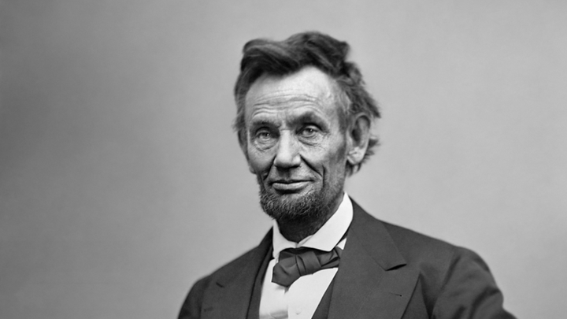
Meanwhile…
In the first months of 1861, Union soldiers trapped inside of Fort Sumter started running low on supplies.
President Abraham Lincoln had taken office and endeavored to reinforce the beleaguered soldiers.
South Carolina Governor Francis Pickins refused to authorize the reinforcements and instead, demanded the fort’s surrender.

Slide 8
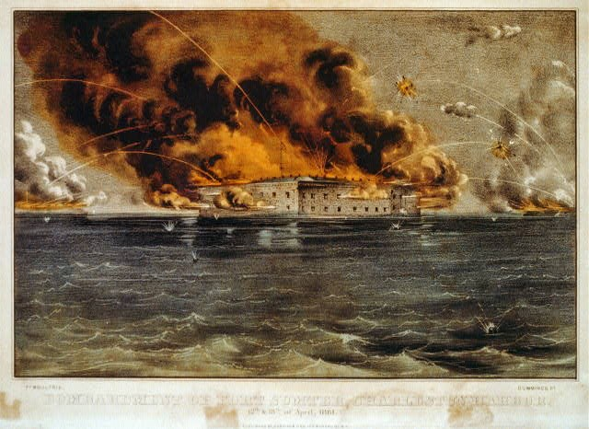
The Bombardment
Following Anderson’s refusal to surrender the fort, Confederate forces began bombarding it at 4:30 A.M. on April 12, 1861. This is considered the official start of the Civil War
Anderson’s men were outmanned and outgunned and lasted about 34 hours before being forced to surrender.
No soldiers on either side were killed as a result of the bombardment.

Slide 9
The Effect of the Battle
The effects of the bombardment of Fort Sumter were significant.
President Lincoln was forced to request the mobilization of 75,000 troops in preparation for war.
Lincoln’s request resulted in the second wave of secession, as Virginia, Tennessee, North Carolina, and Arkansas, joined the seven other states. The Confederate States of America was complete.

Slide 10
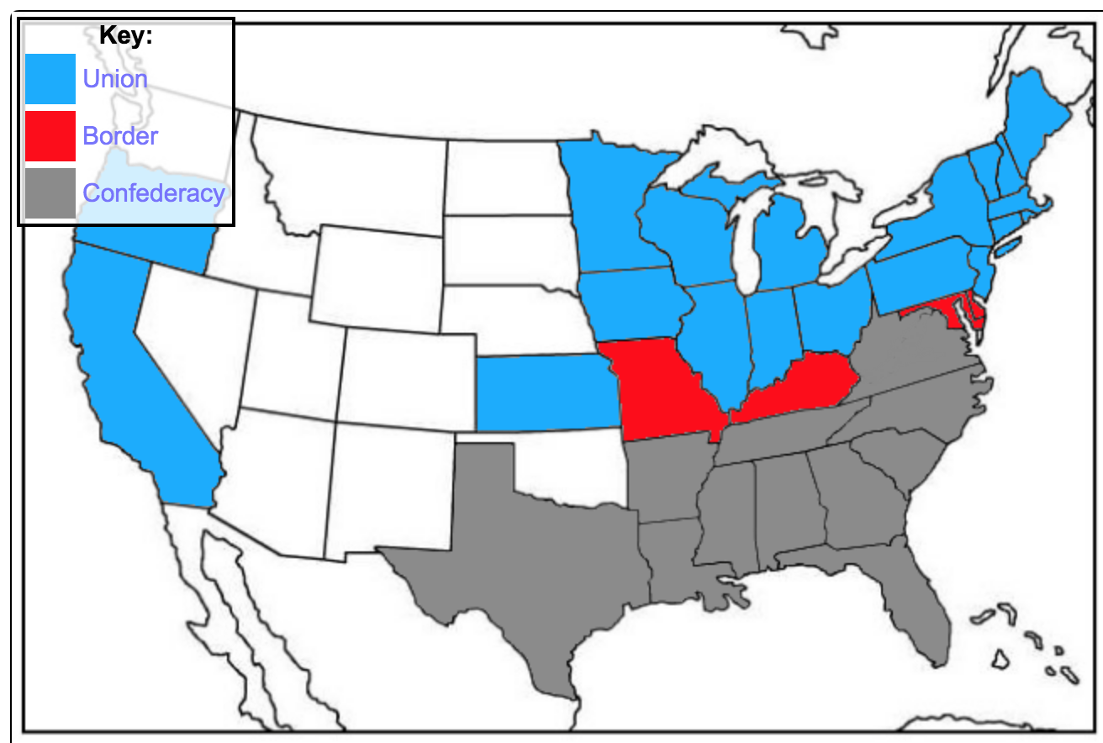
The New Map

